Slide 1
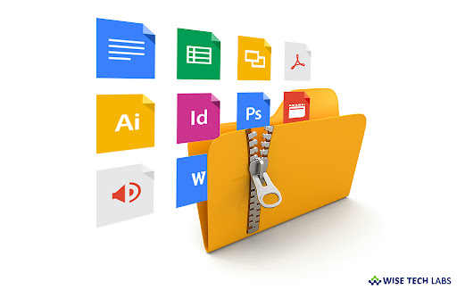
OPERATING SYSTEM PROJECT REPORT TITLE : FILE COMPRESSION TOOL
Presented By: MUHAMMAD AWAIS ALI & ABDUL AHAD
Course Instructor: MR SYED YAWAR ABBAS

Slide 2
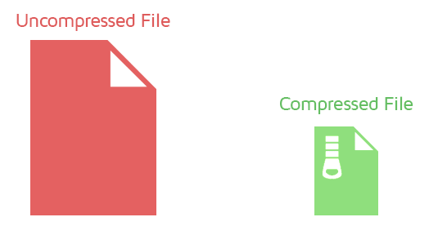
WHY FILE COMPRESSION TOOL ?
REASON: The primary goal of this project is to design and implement a File Compression Tool that provides users with a simple, efficient, and secure way to compress and manage files. .
Key Objectives
File Compression Functionality:
Support for Standard Compression Formats:
File Integrity Verification:
Customizable Compression Levels:
FORMATS : This compression tool include formats like zip and gzip compression .

Slide 3

Implementation Details
The project is organized into modular scripts:
main.py – The central script that links compression, integrity check, and GUI modules.
compress.py – Handles the logic for compression using zipfile and gzip.
file_integrity.py – Computes and verifies SHA-256 hashes to check file integrity.
gui.py – Builds the user interface using tkinter with buttons, file pickers, and options.

Slide 4

Tools and Technologies
Programming Language: Python
Python is the core language used to write the entire application.
It was chosen for its simplicity, rich standard libraries, and excellent support for file handling and GUI development.
Libraries/Modules:
These are built-in or third-party tools that simplify coding specific functionalities.
Zipfile and gzip:
Hashlib:
Tkinter:

Slide 5
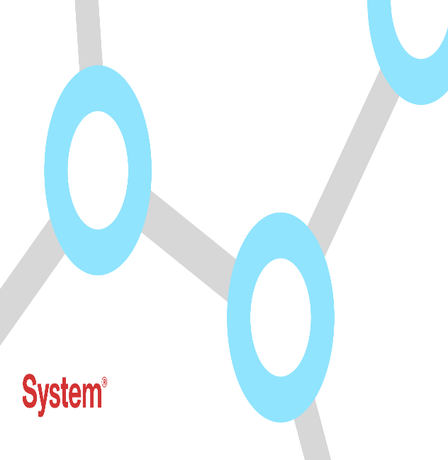
System Architecture Diagram
[User GUI]
↓
[main.py]
├ ─ compress.py (Handles .zip and .gzip operations)
├ ─ file_integrity.py ( Generates and checks SHA-256 hashes)
├ ─ gui.py GUI Design (Tkinter-based user interface)

Slide 6

GUI Design
The GUI is designed using Python's tkinter library. It features:
File and folder selection dialogs
Dropdown to choose compression format
Buttons for Compress and Verify Integrity
Status logs and integrity check outputs

Slide 7

Conclusion & Future Enhancements
The file compression tool achieved its intended goals by enabling users
to compress files efficiently
while maintaining data integrity.
The inclusion of both .zip and .gzip formats, integrity checking, and batch functionality makes it a practical utility for everyday use.

